Slide 1
Capital Stocks User Guide
Marianthi Dunn, Kris Johannsson, Trina Evans, Kelly Thomas
29th July 2022

Slide 2
Content
Role of capital measures in framework of economic accs
Define capital stocks concepts
What is the PIM and how does it work
Accessing R packages to run the PIM
Explaining the input files
Practical demonstration
Future developments

Slide 3
The role of capital stocks in the system of economic accounts
Marianthi Dunn
29th July 2022

Slide 4
Role of capital
Income and wealth perspective
Using market value (current replacement costs)
Working out the future income streams from the asset and calculating them back to NPV
Production/productive perspective i.e. the efficiency of assets

Slide 5
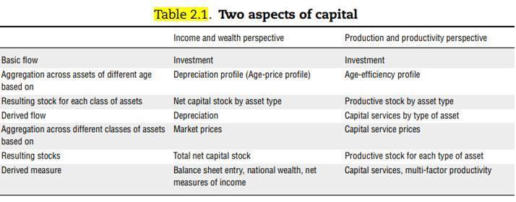
The role of capital

Slide 6
Role of capital measures in SNA 2008
BALANCE SHEET
Net Stock
Net value added
Prod ACC
Age-price function
ACCUM
ACC
Return on capital
CFC
Investment
Gross Stock
User costs
GEN
INC
ACC
Retirement
Function
Productive stock
Capital services
Age-efficiency function

Slide 7
What are capital stocks?
Capital stocks are a group of products with certain common characteristics that are consistent with the asset boundary definition in the UN’s System of National Accounts 2008.
This group of products is known as fixed assets.
These are produced assets : exist as a result of the production process and have a service life in excess of one year. Exclude: financial assets, inventories, valuables and non-produced assets (land).

Slide 8
Capital stocks statistics
We produce estimates of gross capital stock, net capital stock and consumption of fixed capital by asset, industry and sector in current prices, chained-volume measures and previous year’s prices.
Preliminary publication – April/May (experimental statistics)
Blue Book – October (Nat Stats)
Annual publication – Nov/Dec (Nat Stats)
OECD database – December (Nat Stats)

Slide 9
Common definitions
Marianthi Dunn
29th July 2022

Slide 10
Gross capital stocks
Show current replacement cost of the asset in today’s prices.
Are valued at their “as new” prices, regardless of their actual age and condition – “replacement cost”
Values have not deducted consumption of fixed capital.
Gross values ignore decay of assets and consider past investments “as new” – only retirement is considered.

Slide 11
Consumption of fixed capital
Decline in the current value of the stock of fixed assets owned and used by a producer as a result of:
Physical deterioration
Normal obsolescence
Normal amounts of accidental damage

Slide 12
Consumption of fixed capital
Treated as a cost of production – measures the decline in value of fixed assets that can be attributed to their use in production
Valued at current prices rather than prices when assets were first put into service (or volume measures at constant prices of a base year).
CFC reflects the amount that would have to be invested during the accounting period to hold real wealth constant, ceteris paribus.

Slide 13
Net capital stocks
Net capital stocks – measure the market value of capital.
Values are determined by the flows of investment and depreciation.
“Net” distinguishes the depreciated capital stock from the undepreciated or “gross” stock.
Net values are seen as better measures of the “sustainable level of consumption” than gross.
However, variation in asset lives may distort international comparisons of Net Domestic Product, Net National Income, Net Disposable Income.

Slide 14
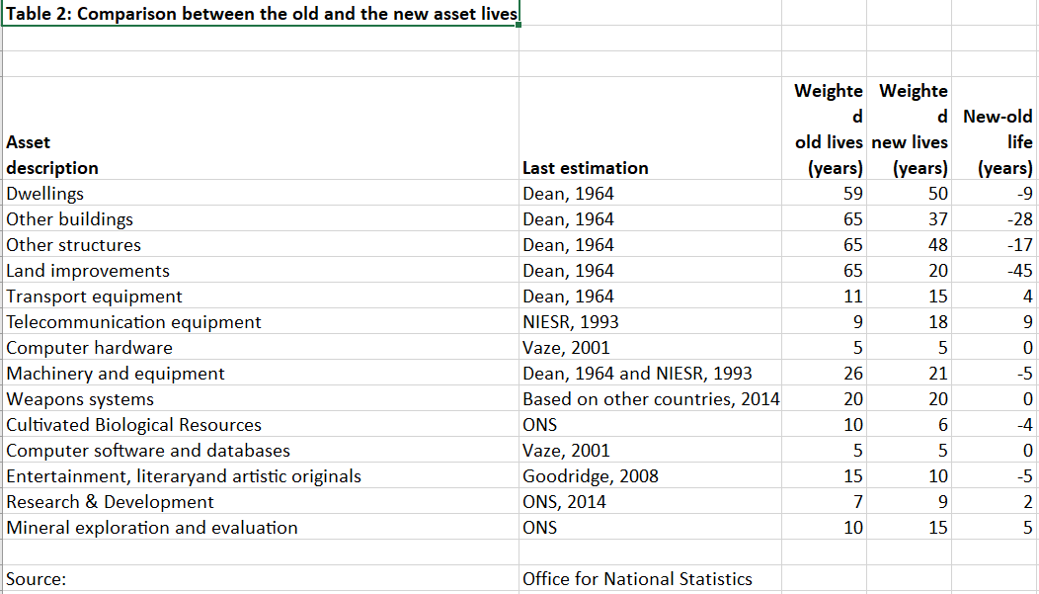
Asset service life
This is the economically useful life of an asset.
It is the amount of time an asset is expected to contribute to the production process

Slide 15
Age-price profile
Age-price profile – “value concepts”
This is the price index of a capital good with regard to its age.
The age-price profile compares identical capital goods of different age at the same point in time
Empirical studies suggest age-price profiles are generally convex to the origin. There are 2 types: straight line and geometric

Slide 16
Age-efficiency profile
Age-efficiency profile – shows losses in an asset’s productive efficiency
Describes an asset’s productive capacity over its service life. The index is set to equal 1 for a new asset and becomes 0 when the asset has reached the end of its service life.
The decline in productive capacity is a result of wear and tear of the asset
Can be straight-line, hyperbolic and geometric.

Slide 17
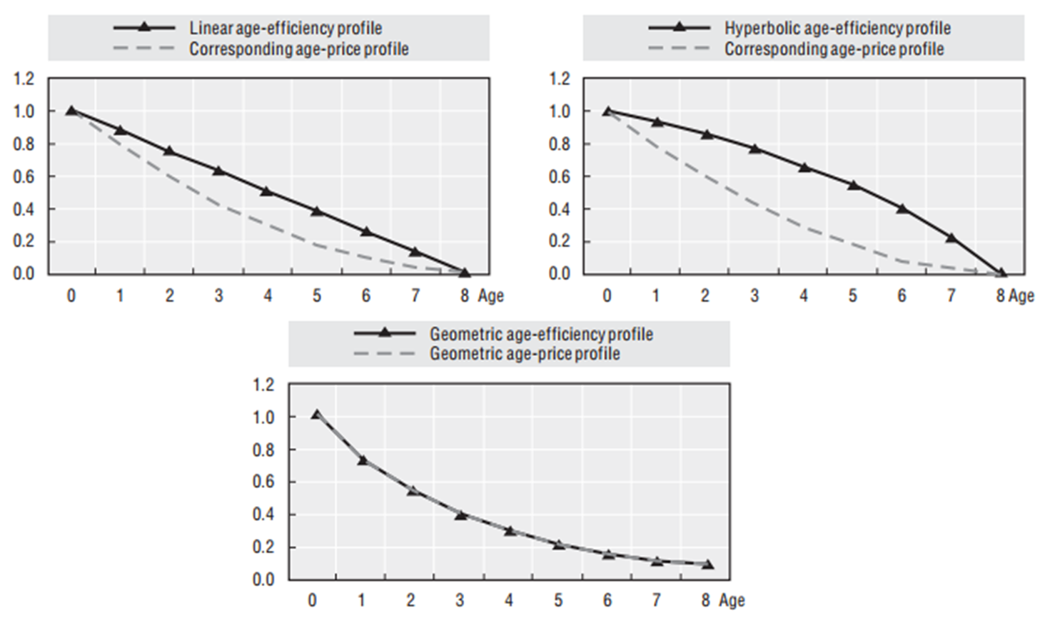
Define capital stocks- comparing profiles

Slide 18
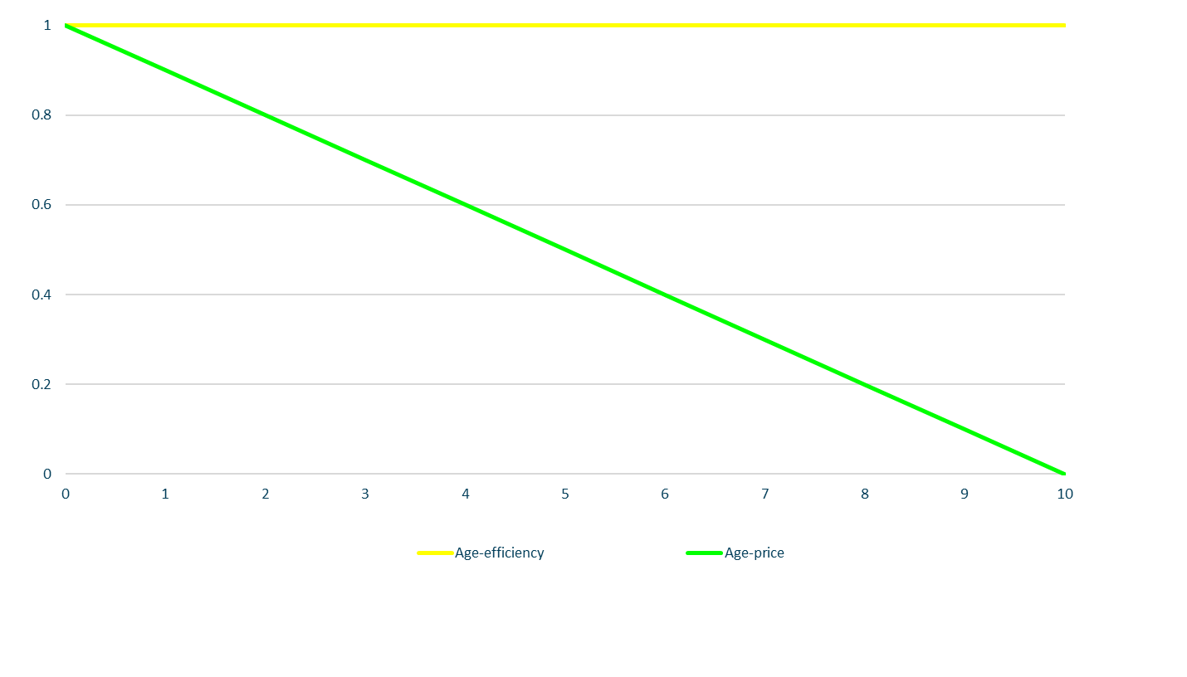
Age-Price vs Age-Efficiency of light bulb

Slide 19
Depreciation, retirement and obsolescence
Depreciation Profile: This is the value loss of an asset because of ageing, expressed as a percentage of the value of a new asset.
Retirement: the act of putting an asset out of service because it has reached the end of its service life.
Obsolescence: loss in value of existing capital because it is no longer technologically suited to economic conditions or because superior alternatives become available.
This is the price index of a capital good with regard to its age.
The age-price profile compares identical capital goods of different age at the same point in time
Empirical studies suggest age-price profiles are generally convex to the origin. There are 2 types: straight line and geometric

Slide 20
The PIM process
Marianthi Dunn
29th July 2022

Slide 21
To produce capital stocks we need:
A long time series of investment flows, known as gross fixed capital formation (GFCF) data; the earliest series start in 1828 for dwellings and other buildings and structures
A set of deflators to accompany the investment data
A set of assumptions around the depreciation and retirement profiles of assets, based on the industry they are servicing
A method which is based on the simple concept that stocks consist of cumulated flows of investment, corrected for retirement and efficiency loss; this is the role of the Perpetual Inventory Method (PIM).

Slide 22
Producing capital stocks estimates: inputs
Asset service lives
Depreciation or retirement function
Discount rate
Gross fixed capital formation time series

Slide 23
Producing capital stocks estimates: profiles
Asset lives are combined with the depreciation or retirement function to derive the following profiles:
1. age-efficiency profiles
2. age-price profiles, derived using discount rates from age-efficiency profiles
3. retirement profiles
4. cohort combined age-price and retirement profiles
We combine these profiles with gross fixed capital format

Slide 24
Producing capital stocks estimates: outputs
We combine these profiles with gross fixed capital formation to derive the following outputs:
gross stock, which is estimated using retirement profiles
productive stock, which is estimated using age-efficiency profiles
capital services, which are derived from productive stock estimates
net stock, which is estimated using combined retirement and age-price profiles
consumption of fixed capital, which is derived from net stock estimates
.

Slide 25
The PIM Process
GFCF time series
Asset service lives
Retirment profiles
Gross stock
Depreciation – retirement function
Age-efficiency profiles
Productive stock
Discount rate
Age-price profiles
Capital services
Cohort combined age-price and retirement profiles
Key
Input data
Process
GFCF time series
Net stocks
CFC
Output data

Slide 26
Accessing R packages and explaining the PIM inputs
Kris Johannsson
29th July 2022

Slide 27
A practical demonstration
Trina Evans
29th July 2022

Slide 28
Forecasting & Changing Assumptions

Slide 29
Forecasting
Current estimates extend to Quarter 4, 2021
Sheets to extend in ‘PIM_Input.xlsx’:
Investment (GFCF_CP)
Deflators (Price_index)
Over 1,700 series of GFCF

Slide 30
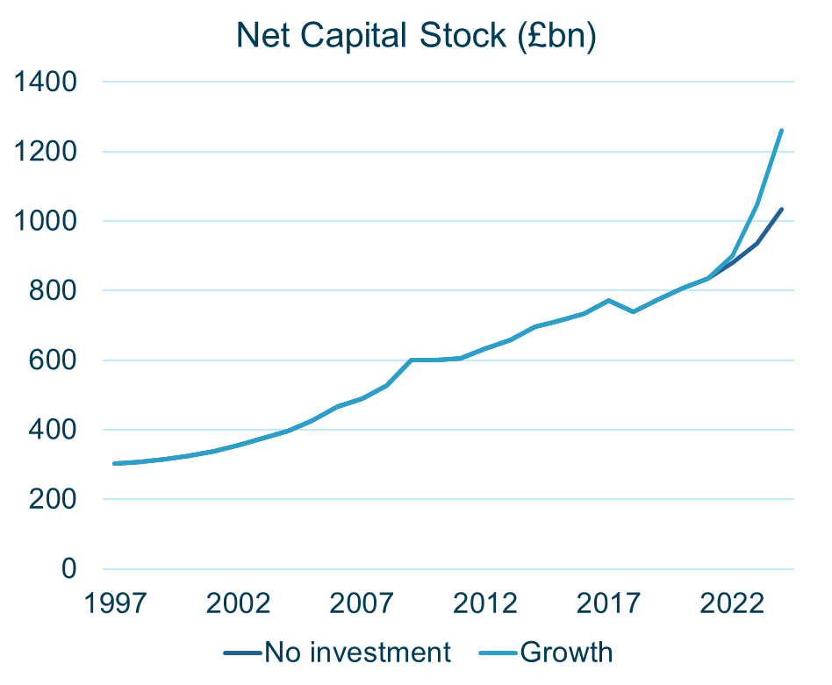
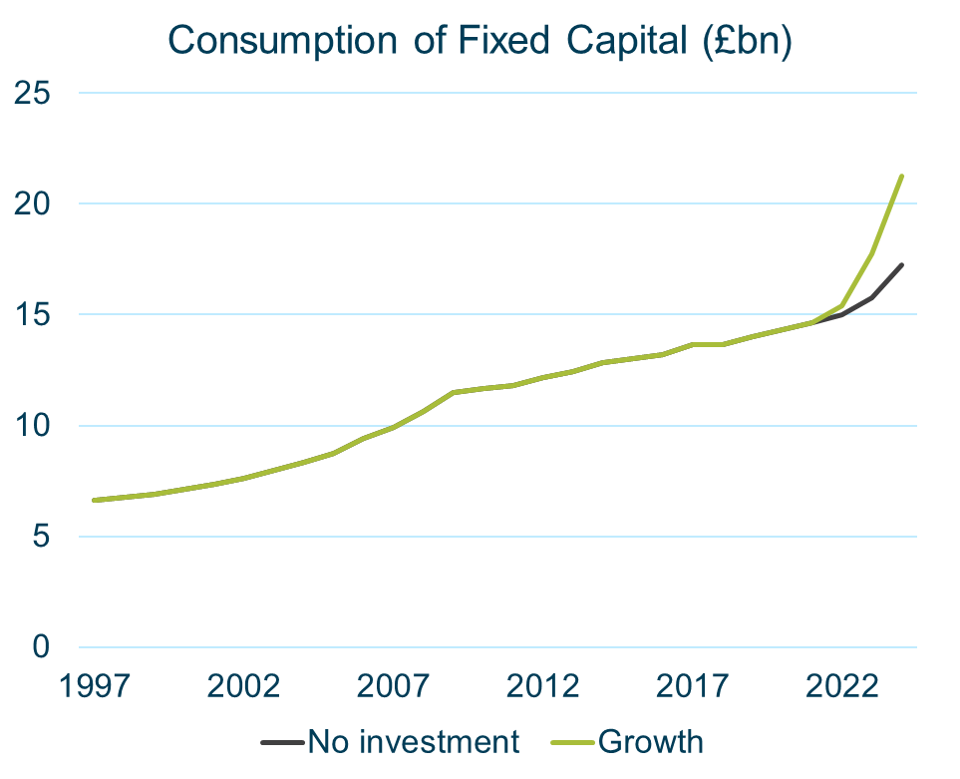
Example forecasted outputs (Public Sector)

Slide 31
Asset Service Lives
Total period during which an asset remains in use, or ready to be used, in a productive process
A longer service life
Asset is retained in capital stock for longer
Consumption of capital spread over a longer time period

Slide 32
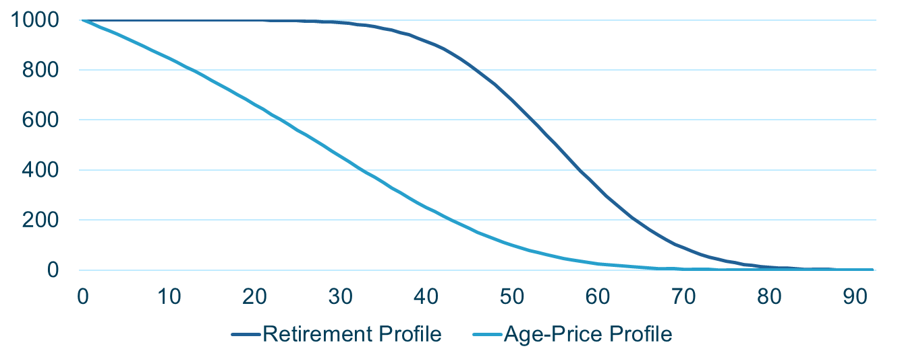
Minimum, Average & Maximum Life Lengths
Other Structures, GF0703 (Hospital Services), Central Government
Minimum | Average | Maximum
1 year | 55 years | 99 years

Slide 33
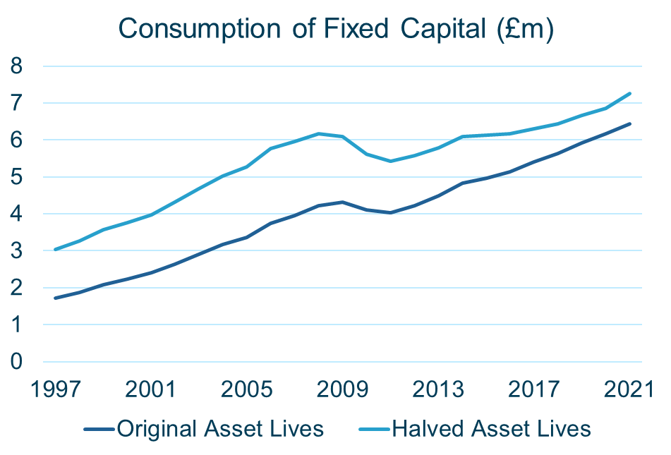
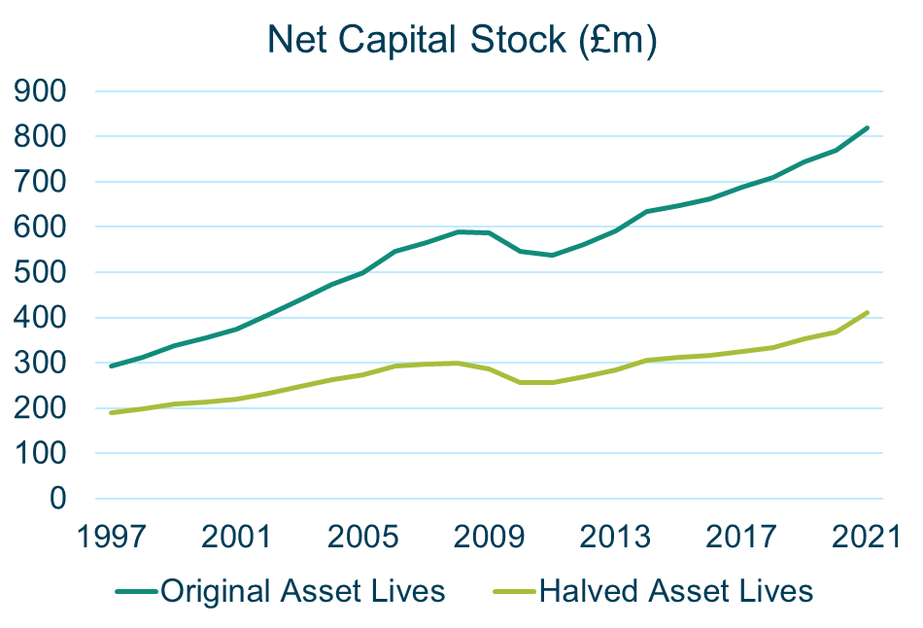
Example output of halved asset lives
Other Structures, GF0703 (Hospital Services), Central Government

Slide 34
Future developments
Fine-tuning code in new R version
Capital stocks user-forums: wider engagement with to better understand their evolving needs
Aligning the GFCF series used in nat accs and capital stocks for all sectors. NAIP and PSF statistics development plan
Review capital stocks and services, production systems for coherent income, wealth and productivity concepts.
Researching concept of inclusive wealth and inclusive income in Beyond GDP development programme.
.

Slide 35
Links to publication
Published packages, R scripts & user guide on GitHub
https://github.com/ONSdigital/Capstocks
Supporting methodology article on ONS website
https://www.ons.gov.uk/economy/nationalaccounts/uksectoraccounts/methodologies/capitalstocksuserguideuk
An updated QMI
https://www.ons.gov.uk/economy/nationalaccounts/uksectoraccounts/methodologies/capitalstocksandfixedcapitalconsumptionqmi

Slide 36
Thank you for listening! Any Questions?
Capstocks@ons.gov.uk

